Slide 1


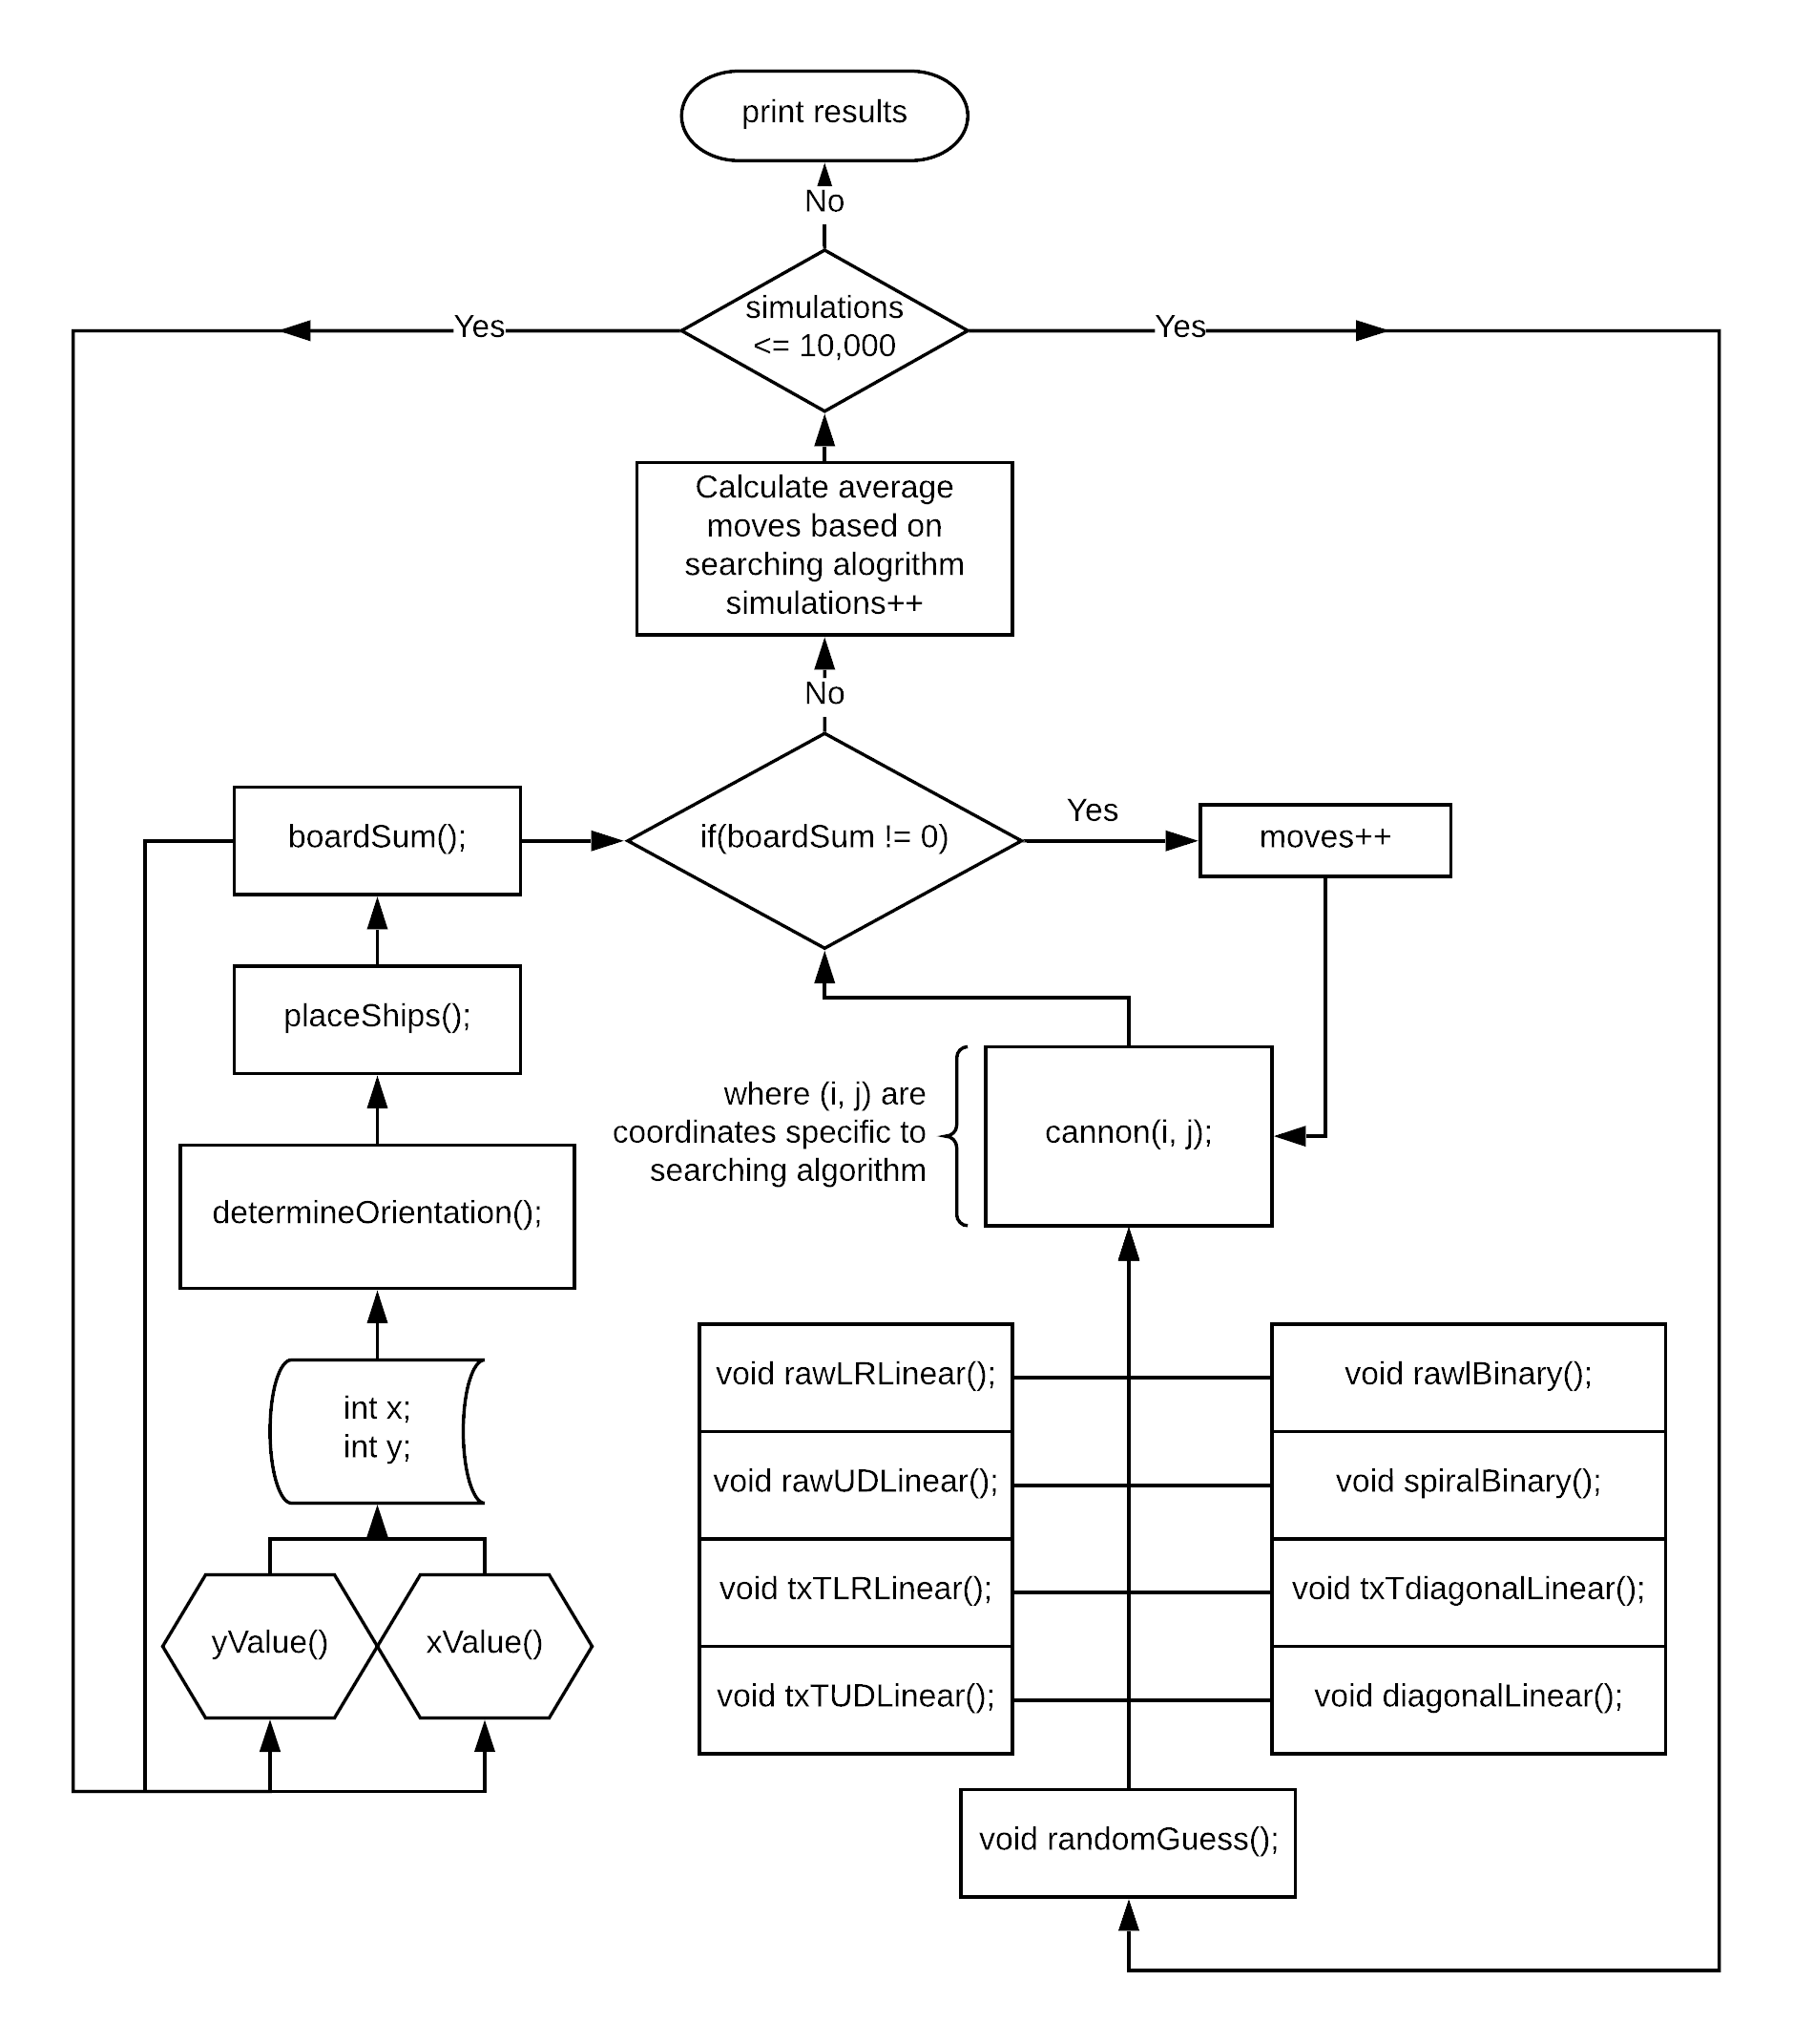
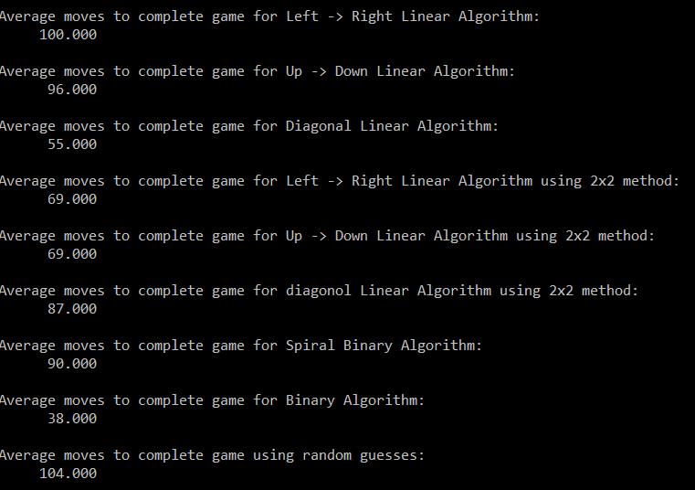
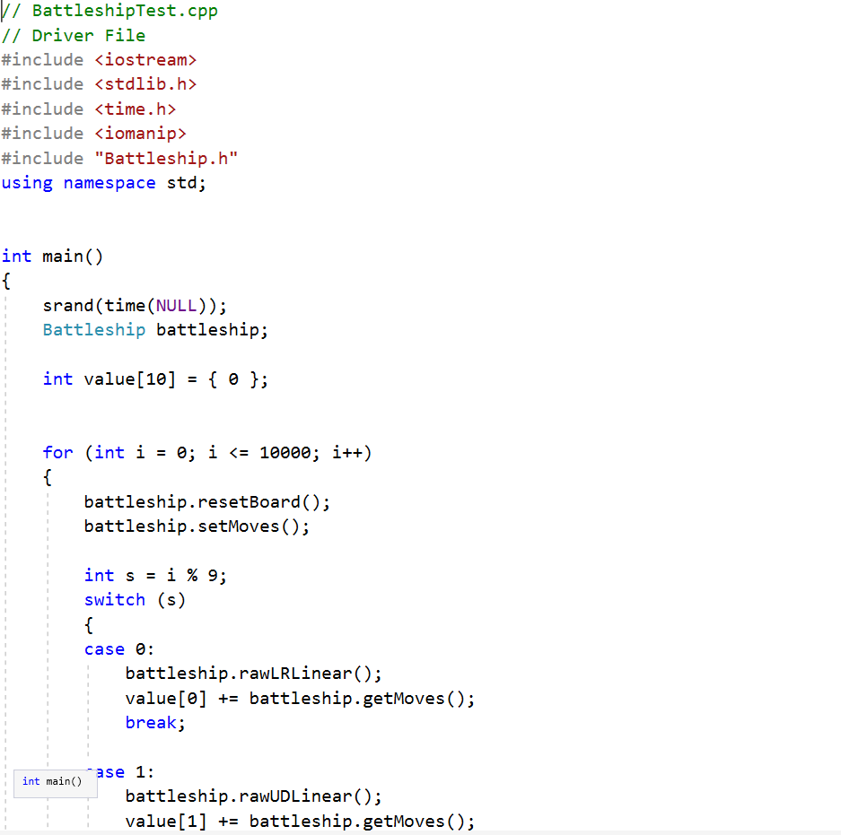
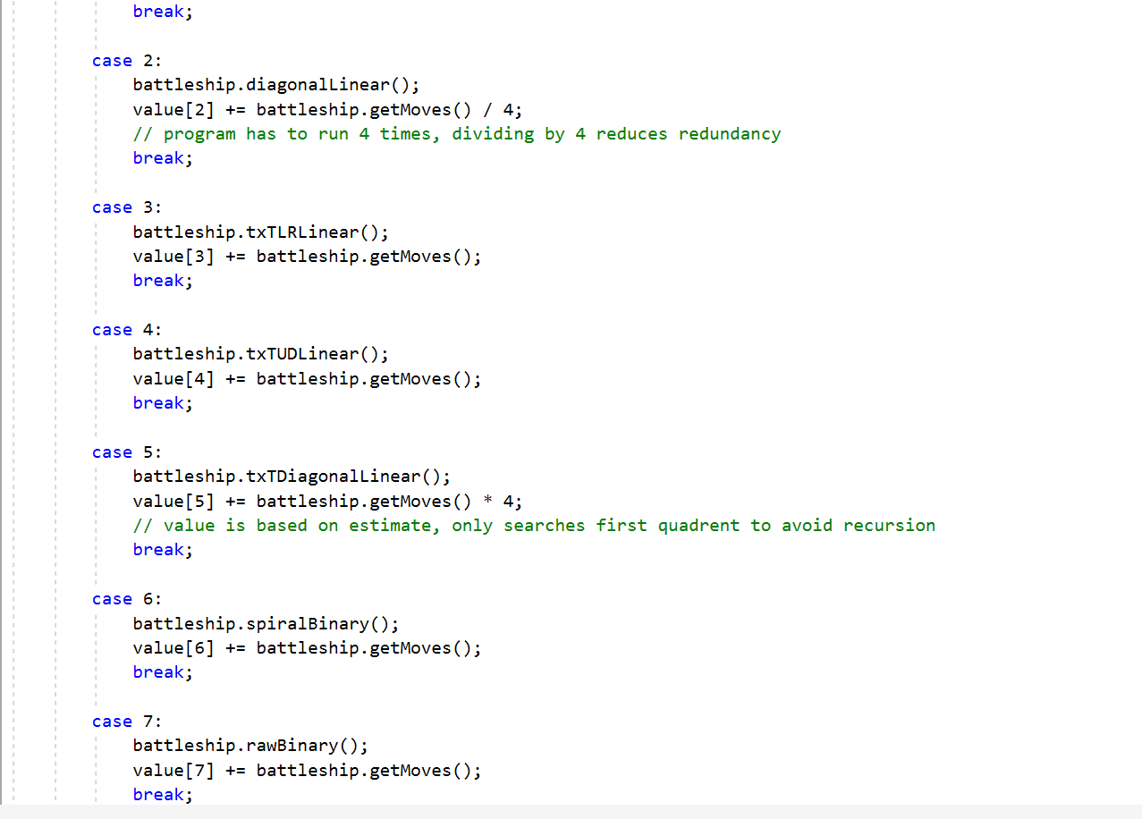
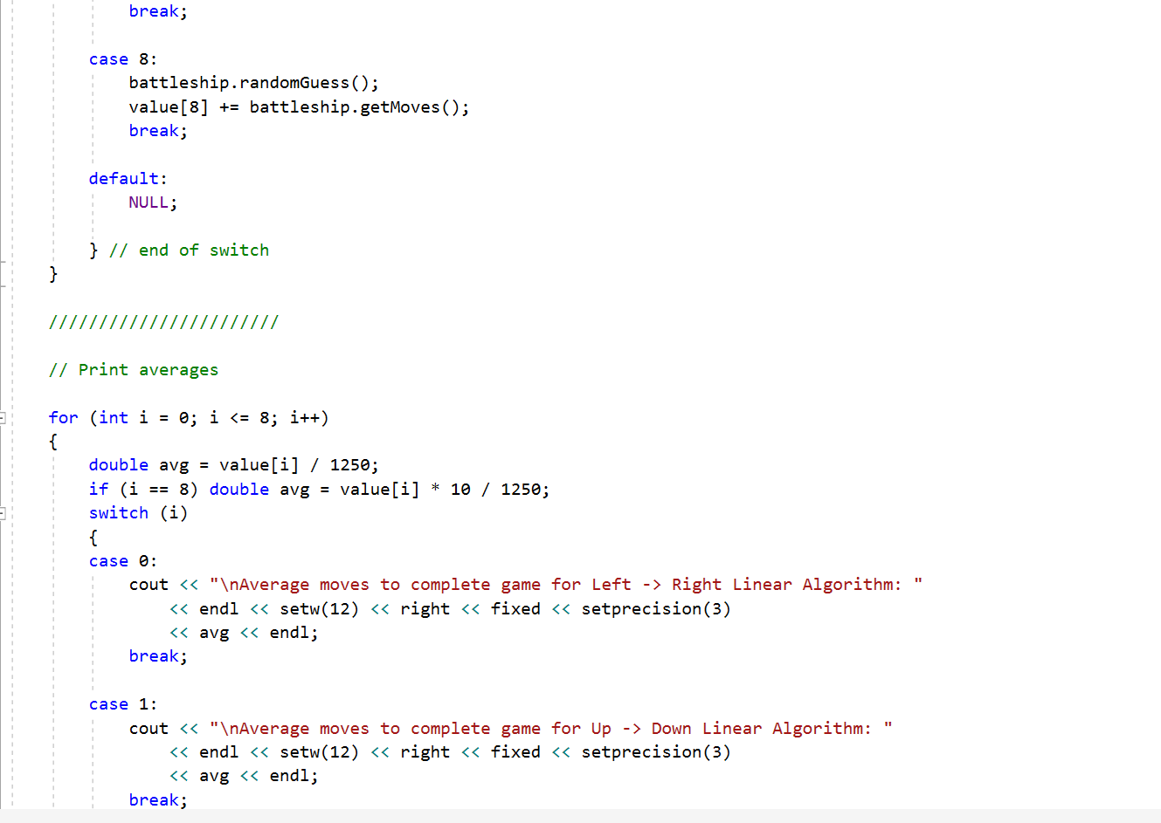




Implementation and Study of Searching Algorithms using Game Theory and Computational Modeling on the Battleship Board Game
Joseph Sivits
Faculty Advisor: Dr. Victor Govindaswamy
Concordia University Chicago
,
Code Sample
Code Output
Abstract
Flow Diagram
This project simulates the popular board game “Battleship”—the program implements nine different searching algorithms. The algorithms consist of various binary and linear searching algorithms, as well as a randomly seeded random searching algorithm. The application will randomly chose different battleship positions, with proper orientation of the ships taken into account as well, making sure the no two battleships exist in the same place. It will then calculate the efficiency of the application by averaging how many moves it takes on each algorithm to find all of the battleships over the course of 10,000 simulations of the game.
Output Analysis
Purpose
The purpose of this project is to test different searching algorithms across a two-dimensional array to determine which searching algorithm is the fastest and would provide the competitor with the best advantage using game theory and computational modeling.
Description of Algorithms
rawLRLinear – Linearly searches for ships on the board in Left -> Right, Up -> Down fashion of (x, y), (1, 1), (3, 1), (5, 1), etc. Skips every other space to fulfill a “checkerboard” pattern.
rawUDLinear – Linearly searches for ships on the board in Up -> Down, Left -> Right fashion of (x, y), (1, 1), (1, 3), (1, 5), etc. Skips every other space to fulfill a “checkerboard” pattern.
diagonalLinear – Linearly searches for ships on the board in a diagonal fashion of (x, y), (1, 1), (1, 3), (3, 1), etc. Skips every other space to fulfill a “checkerboard” pattern.
txTLRLinear – Similar to the rawLRLinear search, but breaks board into 2x2 sections.
txTUDLinear – Similar to the rawUDLinear search, but breaks board into 2x2 sections.
txTDiagonalLinear – Similar to diagonalLinear search, but breaks board into 2x2 sections.
spiralBinary – Binary search, starts from the middle of the two-dimensional ray and searches in the fashion that looks like a spiral counter-clockwise.
rawBinary – Binary search, starts from the middle of the two-dimensional array and follows half-interval search.
randomGuess – Randomly searches the two-dimensional array.
Future Work
In the future I would like to modify my program to be a full-fledged game, with working scoreboard, two-player capability and a working user interface. This wasn’t necessary for this study, but it would be a great side-project.
The brute force algorithms such as LRLinear, UDLinear, and randomGuess prove to be the least efficient. When the “two by two” method is applied , efficiency is improved ~30%. Raw binary search appears to be the most efficient. When the simulation is executed, the output is consistent proving reliability for each algorithm.
Contact
Bioinformatics And Technology Laboratory (BAT Lab)
Computer Science II Group
Computer Science Program (CSC@CUC)
Member: Joseph Sivits
crf_sivitsja@cuchicago.edu
Advisors: Dr. Visvasuresh (Victor) Govindaswamy
Victor.Govindaswamy@cuchicago.edu
Address: Concordia University Chicago
7400 Augusta Street
River Forest, IL, 60305
Technologies Used
Notes:
In data analysis put that probability odds through various tests
Exponential search

Slide 2

Implementation and Study of Artificial Intelligence Using Limited Memory Methods on Blackjack Card Game
Joseph Sivits
Faculty Advisor: Dr. Victor Govindaswamy
Concordia University Chicago
,
Code Sample
Code Output
Abstract
Flow Diagram
This project applies artificial intelligence (AI) concepts such as limited memory to apply probabilities and statistics to formulate the ideal way to win the card game “Blackjack.” The AI is trained through cross-referencing training based on win-percentages and “hit-until-busts,” to find the most idealistic way to play the game.
Purpose
The purpose of this project is to familiarize myself with artificial intelligence concepts to develop a computational model of blackjack—which would affirm popular beliefs and disprove popular myths about strategies to win the game, as well as to make an AI that plays blackjack better than the average person.
Output Analysis
Future Work
Description of Algorithms
Future work may include implementing this program in a machine-learning environment. Such environments for implementation may include Python and R. Machine learning would add a second-layer of complexity as currently the AI functions as through a user-defined algorithmic approach, a computer-generated approach would be better for modeling tendencies of blackjack.
rawLRLinear – Linearly searches for ships on the board in Left -> Right, Up -> Down fashion of (x, y), (1, 1), (3, 1), (5, 1), etc. Skips every other space to fulfill a “checkerboard” pattern.
rawUDLinear – Linearly searches for ships on the board in Up -> Down, Left -> Right fashion of (x, y), (1, 1), (1, 3), (1, 5), etc. Skips every other space to fulfill a “checkerboard” pattern.
diagonalLinear – Linearly searches for ships on the board in a diagonal fashion of (x, y), (1, 1), (1, 3), (3, 1), etc. Skips every other space to fulfill a “checkerboard” pattern.
txTLRLinear – Similar to the rawLRLinear search, but breaks board into 2x2 sections.
txTUDLinear – Similar to the rawUDLinear search, but breaks board into 2x2 sections.
txTDiagonalLinear – Similar to diagonalLinear search, but breaks board into 2x2 sections.
spiralBinary – Binary search, starts from the middle of the two-dimensional ray and searches in the fashion that looks like a spiral counter-clockwise.
rawBinary – Binary search, starts from the middle of the two-dimensional array and follows half-interval search.
randomGuess – Randomly searches the two-dimensional array.
The brute force algorithms such as LRLinear, UDLinear, and randomGuess prove to be the least efficient. When the “two by two” method is applied , efficiency is improved ~30%. Raw binary search appears to be the most efficient. When the simulation is executed, the output is consistent proving reliability for each algorithm.
Contact
Bioinformatics And Technology Laboratory
(BAT Lab)
Computer Science II Group
Computer Science Program (CSC@CUC)
Member: Joseph Sivits
crf_sivitsja@cuchicago.edu
Advisor:
Dr. Visvasuresh (Victor) Govindaswamy
Victor.Govindaswamy@cuchicago.edu
Address: Concordia University Chicago
7400 Augusta Street
River Forest, IL, 60305
Technologies Used
Notes:
In data analysis put that probability odds through various tests
Exponential search

Slide 3
Implementation of Weather Web App using Networking of
RESTful API, HTML, CSS, JavaScript
Joseph Sivits
Faculty Advisor: Dr. Victor Govindaswamy
Concordia University Chicago
,
Code Sample
Code Output
Abstract
Flow Diagram
This project implements a weather application
that also informs the users what to wear based
on that current weather. By using an application programming interfaces (API) to demonstrate Relational State Transfers, this project uses Client-Server architecture in conjunction with
Purpose
The purpose of this project is to familiarize myself with artificial intelligence concepts to develop a computational model of blackjack—which would affirm popular beliefs and disprove popular myths about strategies to win the game, as well as to make an AI that plays blackjack better than the average person.
Output Analysis
Future Work
Description of Algorithms
Future work may include implementing this program in a machine-learning environment. Such environments for implementation may include Python and R. Machine learning would add a second-layer of complexity as currently the AI functions as through a user-defined algorithmic approach, a computer-generated approach would be better for modeling tendencies of blackjack.
rawLRLinear – Linearly searches for ships on the board in Left -> Right, Up -> Down fashion of (x, y), (1, 1), (3, 1), (5, 1), etc. Skips every other space to fulfill a “checkerboard” pattern.
rawUDLinear – Linearly searches for ships on the board in Up -> Down, Left -> Right fashion of (x, y), (1, 1), (1, 3), (1, 5), etc. Skips every other space to fulfill a “checkerboard” pattern.
diagonalLinear – Linearly searches for ships on the board in a diagonal fashion of (x, y), (1, 1), (1, 3), (3, 1), etc. Skips every other space to fulfill a “checkerboard” pattern.
txTLRLinear – Similar to the rawLRLinear search, but breaks board into 2x2 sections.
txTUDLinear – Similar to the rawUDLinear search, but breaks board into 2x2 sections.
txTDiagonalLinear – Similar to diagonalLinear search, but breaks board into 2x2 sections.
spiralBinary – Binary search, starts from the middle of the two-dimensional ray and searches in the fashion that looks like a spiral counter-clockwise.
rawBinary – Binary search, starts from the middle of the two-dimensional array and follows half-interval search.
randomGuess – Randomly searches the two-dimensional array.
The brute force algorithms such as LRLinear, UDLinear, and randomGuess prove to be the least efficient. When the “two by two” method is applied , efficiency is improved ~30%. Raw binary search appears to be the most efficient. When the simulation is executed, the output is consistent proving reliability for each algorithm.
Contact
Bioinformatics And Technology Laboratory
(BAT Lab)
Computer Science II Group
Computer Science Program (CSC@CUC)
Member: Joseph Sivits
crf_sivitsja@cuchicago.edu
Advisor:
Dr. Visvasuresh (Victor) Govindaswamy
Victor.Govindaswamy@cuchicago.edu
Address: Concordia University Chicago
7400 Augusta Street
River Forest, IL, 60305
Technologies Used
Notes:
In data analysis put that probability odds through various tests
Exponential search

